Slide 1
Customer Churn Prediction
Data Science in collaboration with Product Management

Slide 2
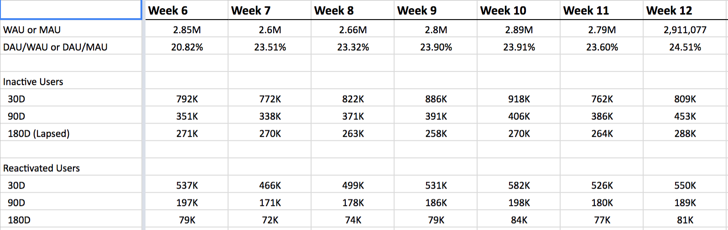
We reactivate less than 30% users churning every week
Need to identify customers at the risk of churn and understand reasons why they disengage

Slide 3
AGENDA
Churn Prediction Algorithm
Goal : Understand reasons why customers churn, identify customers who are at the risk of churn and identify potential levers which we can use to reduce churn
Approach :
Associate a churn probability score for each customer
For churned users, find a set of reasons for their churn / disengagement
For top reasons that lead to churn, work across teams to provide preferential treatment to users at risk of churn

Slide 4
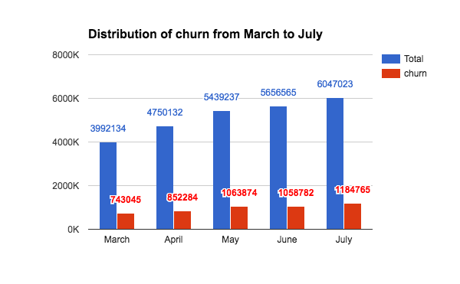
How big is the Churn problem?
A customer is considered to have churned if no booking is completed in the last 180 Days
Ride Frequency | % Share of Churners | % Users churning (LF/HF/MF group)
LF (1-2) | 78% | 26.5%
MF (3-8) | 19% | 11%
HF (>=9) | 3% | 5.3%
Consistently around 20% of our monthly user base is churning out, 5.3% of the HF base in March and July churned out (no completed booking in the next 180 days)

Slide 5
Low frequency users who churned in May (9L users)
Observations
These users might not have any need of regular travel and because of low # of rides taken it is difficult to attribute them as churned. These users have thus been excluded from the analysis.

Slide 6
Bookings Distribution (Pan India)
These percentages are taken at 4 months avg (May, June, July, Aug 2016)
Category | %Total Users | % Bookings
LF (1-3) | 57% | 37%
MF (4-8) | 32% | 20%
HF (>=9) | 11% | 43%

Slide 7
HF Users: Disengaged Vs. Churned
HF users in Aug : 5.4L
Churn: 180D lapsed (0 bookings in 180 Days) : 30.2K
Disengaged : Engagement* falls by >= 80%
* Engagement is calculated as average monthly bookings in next 6 months
Percentile users | Fall in engagement(180D)
0% | 0
10% | 0
20% | 0.0
30% | 0.24
40% | 0.41
50% | 0.55
60% | 0.67
70% | 0.77
73% | 0.80
80% | 0.87
90% | 0.93
100% | 1
Category | # Users | % Users
Engaged | 401240 | 73.4%
Disengaged | 144830 | 26.5%
Churned | 30230 | 5.5%

Slide 8
Model Features
Pricing / ATS
Blended Rate_3mnths
ATS_3mnths
Last ride peak multiplier
% Peak rides taken
Customer profile
Classification Model
Time_since_signup
# Completed rides
Preferred category
% Category rides
Avg. ATA-ETA
Avg_Distance per ride_3mnths
Cancellation
% Driver cancellations
% DDD
% Customer cancellations
Availability
Stockouts
Customer Feedback
Avg. Ride Rating
Calls to customer care

Slide 9
Prediction Model(s)
Model V0
Model V1
Regularised Logistic Regression
Gradient Boosting (XgBoost)
Train Data : Total 203172
Test Data : Total 163821
Precision : 62%
Recall : 51%
Train Data : Total 203172
Test Data : Total 163821
Precision : 70%
Recall : 51%
To remove high class imbalance we under sample engaged users so that we get Engaged and Disengaged in 1:1 ratio.

Slide 10
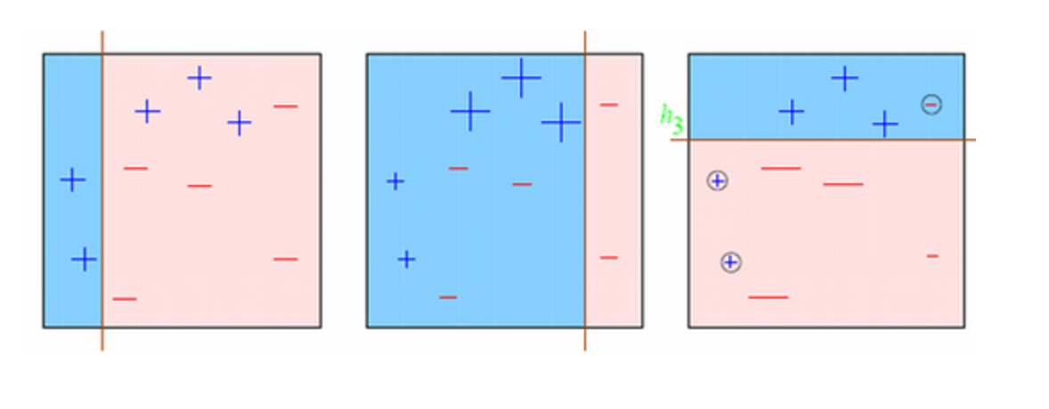
Why XgBoost?
Sequential technique which works on the principle of ensemble. It combines a set of weak learners and delivers improved prediction accuracy.
Memory optimisation to make it run faster.
Works better with higher dimension data.

Slide 11
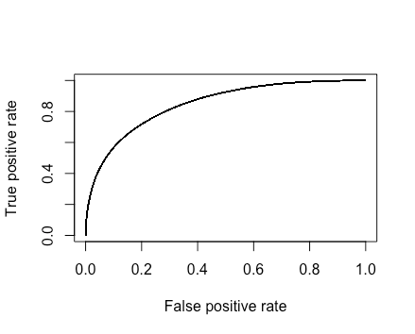
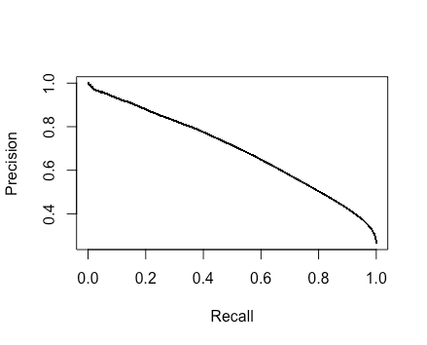
ROC curve and PR curve of XG boost Model
(0.51,0.7)
(0.17,0.51)
AUC=0.84
*Precision is the fraction of retrieved instances that are relevant, while Recall (also known as sensitivity) is the fraction of relevant instances that are retrieved.

Slide 12
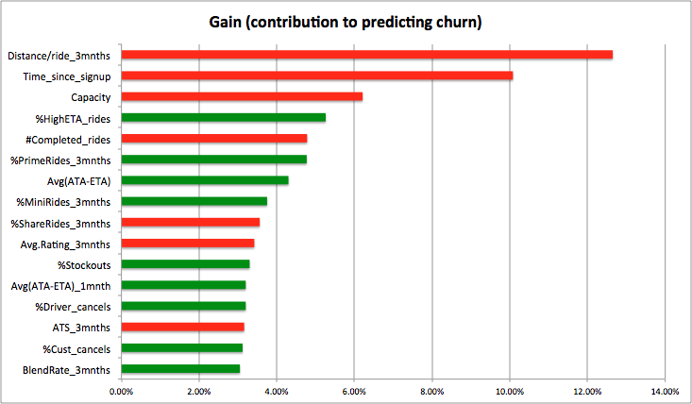
Top features that explain churn of HF users in Aug
Total Bookings
ATA-ETA
Customer_cancellations
Distance per ride
ATS( Average ticket size)
Blended rate per KM
Calls per ride to customer care

Slide 13
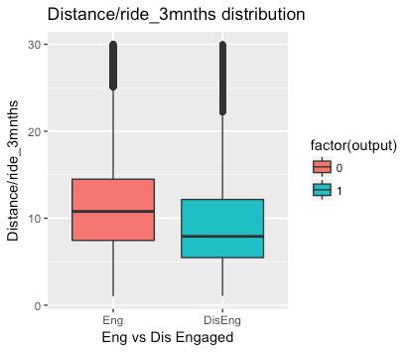
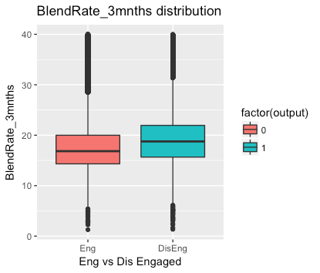
Feature distribution Analysis
HF Users who churn have higher # of total bookings and lower cancelled / completed %

Slide 14
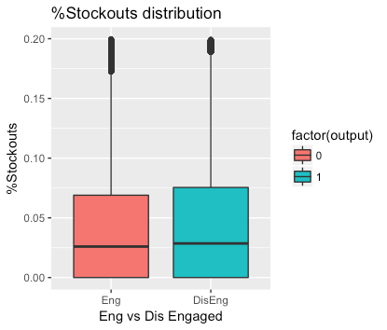
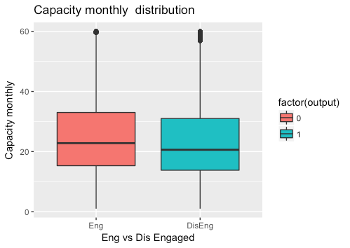
Feature distribution Analysis cont.
Notes:
Keep axis until 0.125 for stockouts, C capital in Monthly capacity, restrict axis to 60

Slide 15
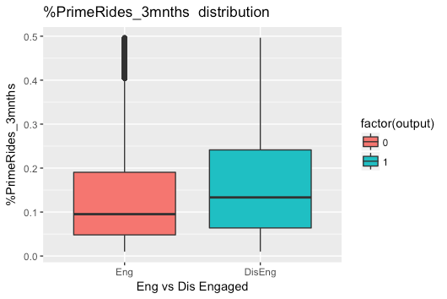
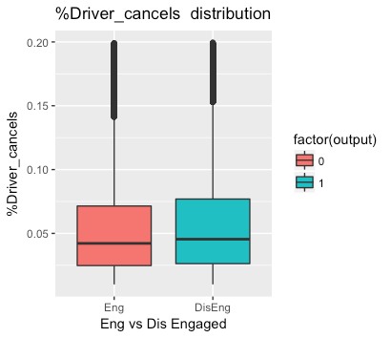
Feature distribution Analysis cont.
Notes:
Keep axis until 0.4

Slide 16
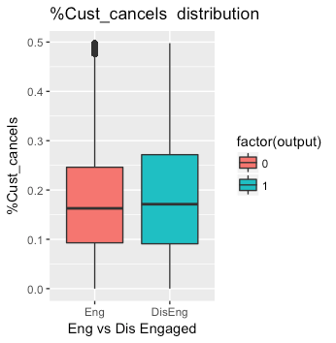
Feature distribution Analysis cont.
Notes:
On this slide remove Mini and Micro, add Driver_ Cancels, Customer_cancels, Avg. (ATA - ETA) / ETA, Avg. rating on two slides

Slide 17
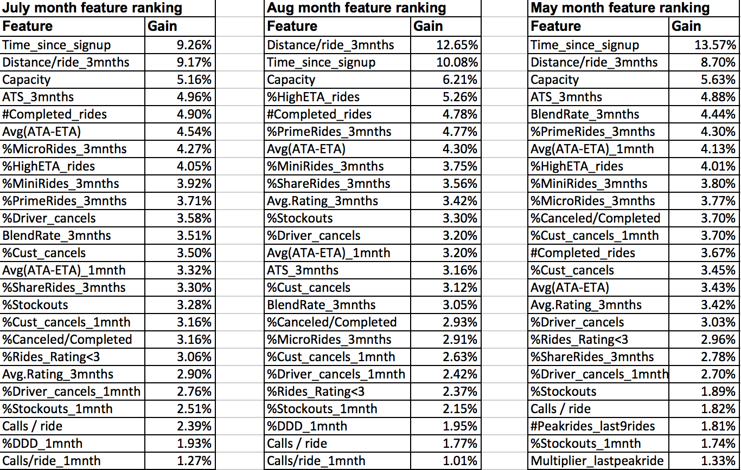

Slide 18
Revenue & Bookings Impact
Average Monthly Revenue(June,July,Aug) of users who got Disengaged (Aug month users) = ~ Rs 27.4 cr
Expected in next 6 months = 27 * 6 = ~ Rs 164.4 cr
Revenue received in next 6 months = Rs 15.2 cr
Revenue Lost in next 6 months = ~ Rs 149.2 cr
Potential revenue can save in six months* = 0.5 (model accuracy) * 149.2
= ~ Rs 74.6 cr
Average Monthly Bookings(June,July,Aug) of users who got Disengaged (Aug month users) = 17.24 L
Expected in next 6 months = 17.24 * 6 = ~ 1cr
Bookings received in next 6 months = 8.5 L
Bookings Lost in next 6 months = ~ 92 L
Potential Bookings can save in six months* = 0.5 (model accuracy) * 92 L = 46 L
*This is only for users we lost in the month of Aug 2016.

Slide 19
DS Next Steps
Build models for different granularities (like 60D, 90D) to predict churn
Work with engineering to productionalize this model
Allow cross-functional teams to access list of users at the risk of churn in realtime to provide preferential service quality
Add more features (e.g. Driver Segments, Location based features)
Scale this model for MF (3-8 bookings) users and try a different approach for LF users

Slide 20
Product / Biz Next steps
Short distance riders are churning faster, one potential reason could be higher pricing Vs competition for short rides, we might need to reduce pricing for short rides and match competition fares
High (ATA - ETA) is a strong reason for customer churn, for HF users we need to show the correct ETA on booking confirmation
Stockouts lead to churn amongst HF users, these users must get prioritised allotment in the Demand queue
# HighETA_rides contribute to churn, for HF users, we need to prioritise allocation with a goal to minimise post booking ETA for them
Notes:
#HighETA_rides: # of rides with User’s Mean ETA + 1 sigma

Slide 21
Product / Biz Next steps
Users with more lifetime rides have a lower propensity to churn, we will identify Regular users with a good history of taking rides and provide preferential service (availability, allocation & better cars / drivers)
Since users with high capacity churn less, such users that show a declining engagement will be automatically sent frequency boosting offers
For HF user rides with low ratings (<=3), we need to maintain and review a weekly summary of the top reasons mentioned for the same, and consistently act on the feedback and compensate the customer when required
Review top reasons for Ola Care contacts from HF customers and publish a weekly summary on the same

Slide 22
Q & A

